Slide 1
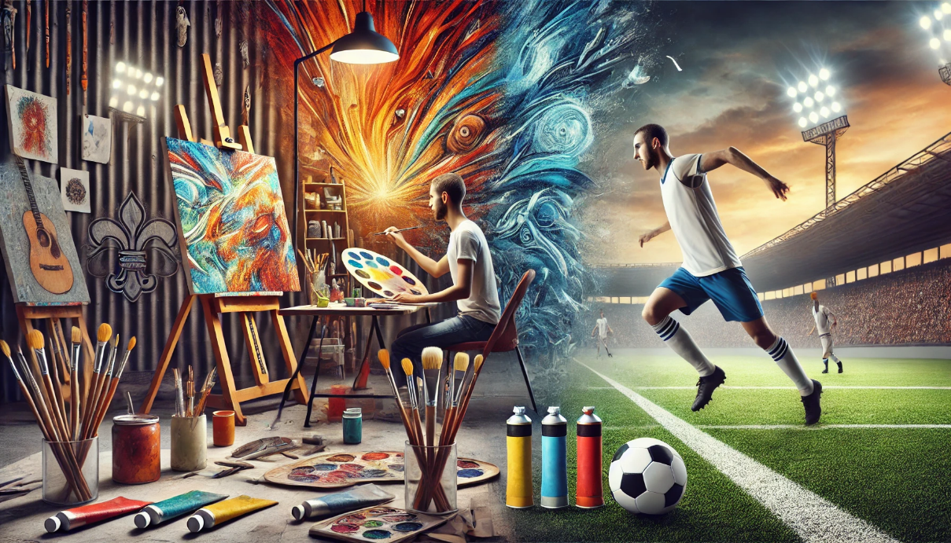
How does sport affect art sentiment?
Valerie Melul
Yuval Saadaty
Internet behavior, Pr. Elad Yom-Tov
November 2024

Slide 2

Data set principles
Internet data from English Reddit forums
Users who posted only in art subreddits
Users who posted in both art and sports subreddits.
Although not natural, potentially not under our control: selection done by users themselves, with our minimal intervention
Notes:
Reddit offers a large, diverse community with active discussions in both art and sports forums.
Explore how engagement in sports could influence sentiment and creativity in art-related discussions.

Slide 3
Data set
Art
Sport
our sample

Slide 4
Sampled subreddits
Art subreddits
artlounge | ArtistLounge
art | ArtCrit
drawings | Learnart
arttutorials | Sculpture
PixelArt | AnimeART
painting | Pastel
OilPainting | Watercolor
Sport subreddits | Sport subreddits
pilates | yoga
Fitness | Workout
Exercise | Walking
zumba | bodybuilding
sports | Running
crossfit | weightlifting
Soccer | basketball
hokey | football
Boxing | baseball
Tennis | cycling
swimming | golf
surfing | climbing

Slide 5

Data selection
Art
unique
?
Sport
Total post count | Unique | 01/2023-11/2024
10,430 | 6,471 | Art only
Art - 932 Sport - 317 | 56 (<1%) | Both art and sport

Slide 6
Examples From The Dataset
User who wrote in art and sport forums:
User: maryobreau Post in art:
Subreddit: ArtistLounge,
Title: To varnish or not to varnish,
Text: Hi all, just to be sure if there is any varnish wisdom to grasp out there : I usually use some satin varnish on my acrylic paintings. I have been doing also some acrylic on paper recently, smaller work. I do a lot of layering and always have a thick pack of paint laying there, also on paper. I was wondering : does varnish make any sense when the painting will be behind (normal) glass eventually ? There's a lot of saturated colors and I would like them to last. Thank you for your experience and keep on creating !
Created at: 2024-11-04 23:04:44 score: 1
Post in sport:
Subreddit: Swimming,
Title: Injury but need the exercise,
Text: Hi all, I'm a regular swimmer, twice a week like 0.6 miles (1 kilometer) front crawl. Unfortunately, I injured both Achilles' heels. I would like to continue my exercise but can't put any effort there. Are there any suggestions on how I could keep on swimming, maybe using any attributes? I'm new to that but maybe this is an opportunity to experiment.. Thanks in advance!
Created at: 2024-07-09 16:31:02 score: 1

Slide 7
Examples From The Dataset
User who wrote only in art forum:
Username: playforthoughts,
Subreddit: ArtistLounge,
Title: Hey guys! I wrote an article exploring Francis Bacon's art through his signature distortion techniques and photographic influences. It’s a deep dive into how he captures psychological tension through raw and isolated portraits. I hope you'll find it interesting and maybe learn something new!,
Text: The link for article is below: [https://www.playforthoughts.com/blog/francis-bacon](https://www.playforthoughts.com/blog/francis-bacon)
Created at: 2024-11-04 22:47:58 Score: 12

Slide 8



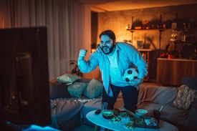
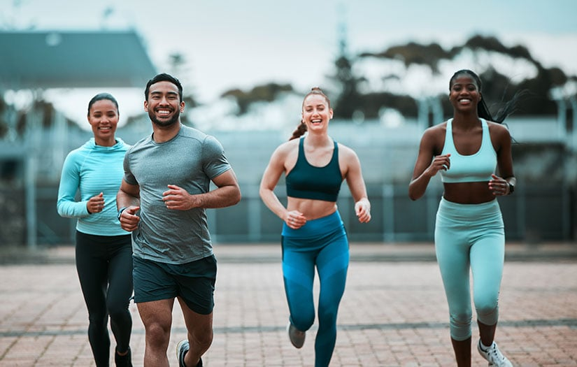
Issues
Find interesting natural experiment
API issues: stuck at registration, outdated anaconda praw library
Imbalance: take all? select from majority and interfere? Go far back in time?
Find more users in both art and sports was time-consuming + few
Which timing between activity periods in both fields?
Translate our interest into concrete subreddits and parsing texts
V
vs
https://www.istockphoto.com/photo/overweight-man-watching-a-soccer-match-gm1084453658-290977139
https://blog.nasm.org/fitness-trends

Slide 9
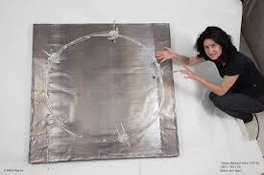
Reactions

